Slide 1

The UX Law of Proximity and Design Improvements
An Overview of UX Principles and Fixes
Presented by, Anslem Peter Coelho Pengcheng Li Samson Maveli Mathews Rahul

Slide 2

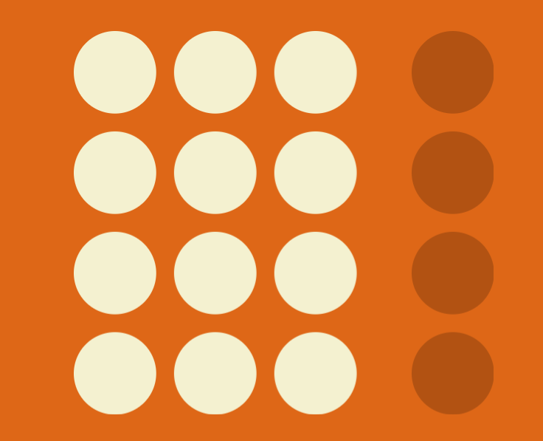
What is the Law of Proximity?
Objects near each other are perceived as a group.
Helps users recognize relationships between elements based on spacing.

Slide 3


Slide 4
History of the Law of Proximity
Originated from Gestalt psychology in the early 20th century.
Developed by German psychologists like Max Wertheimer.
Helps in understanding how humans perceive organized patterns.

Slide 5


Slide 6
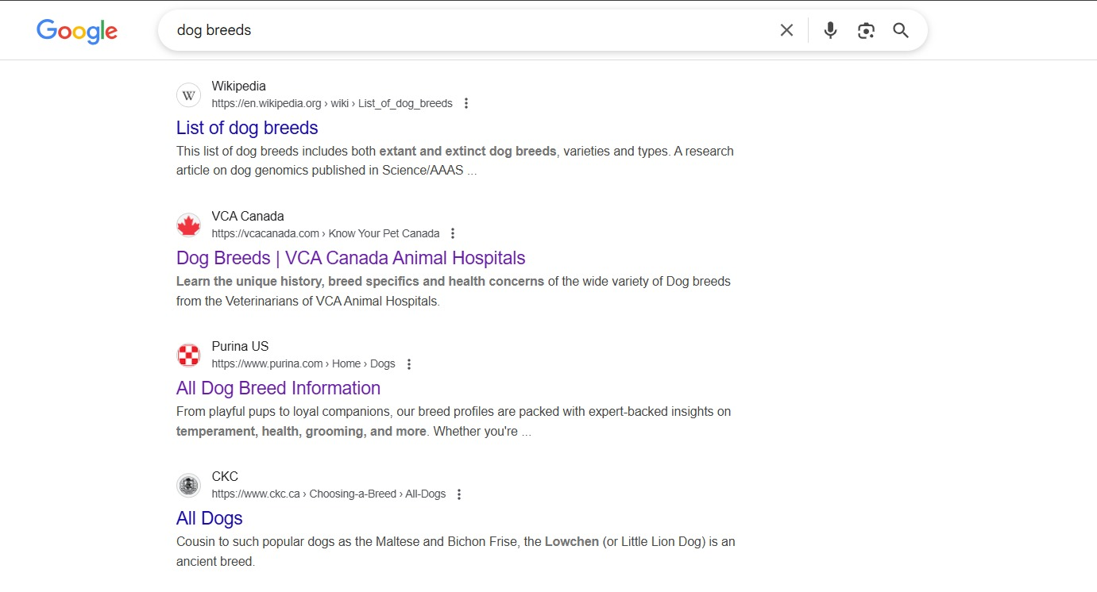

Slide 7

Problems the Law Solves in UX Design
Visual Clarity: Reduces cognitive load.
Navigation Efficiency: Groups related content.
Improved User Experience: Organizes content logically.

Slide 8

Example: Bad Mockup and Fix
Bad: Landing page with scattered buttons of similar size.
Fix: Distinct primary CTA with contrasting colors at the top.

Slide 9


Slide 10

Group's Design-Thinking Approach
Empathize: Understand user pain points through feedback.
Define: Identify the problem clearly.
Ideate: Brainstorm solutions collaboratively.
Prototype: Create wireframes with improved design.
Test: Gather user feedback and iterate.

Slide 11
Conclusion
Applying the Law of Proximity in UX design improves usability and clarity.
Group related elements, maintain consistency, and enhance visual structure.

Slide 12
References
Sb
Rsgbfnmhgcndgngfvbngdnv
Dgbfnbvcbc
Agnmgfxxcvnv

Slide 13
THANK YOU

